Slide 1
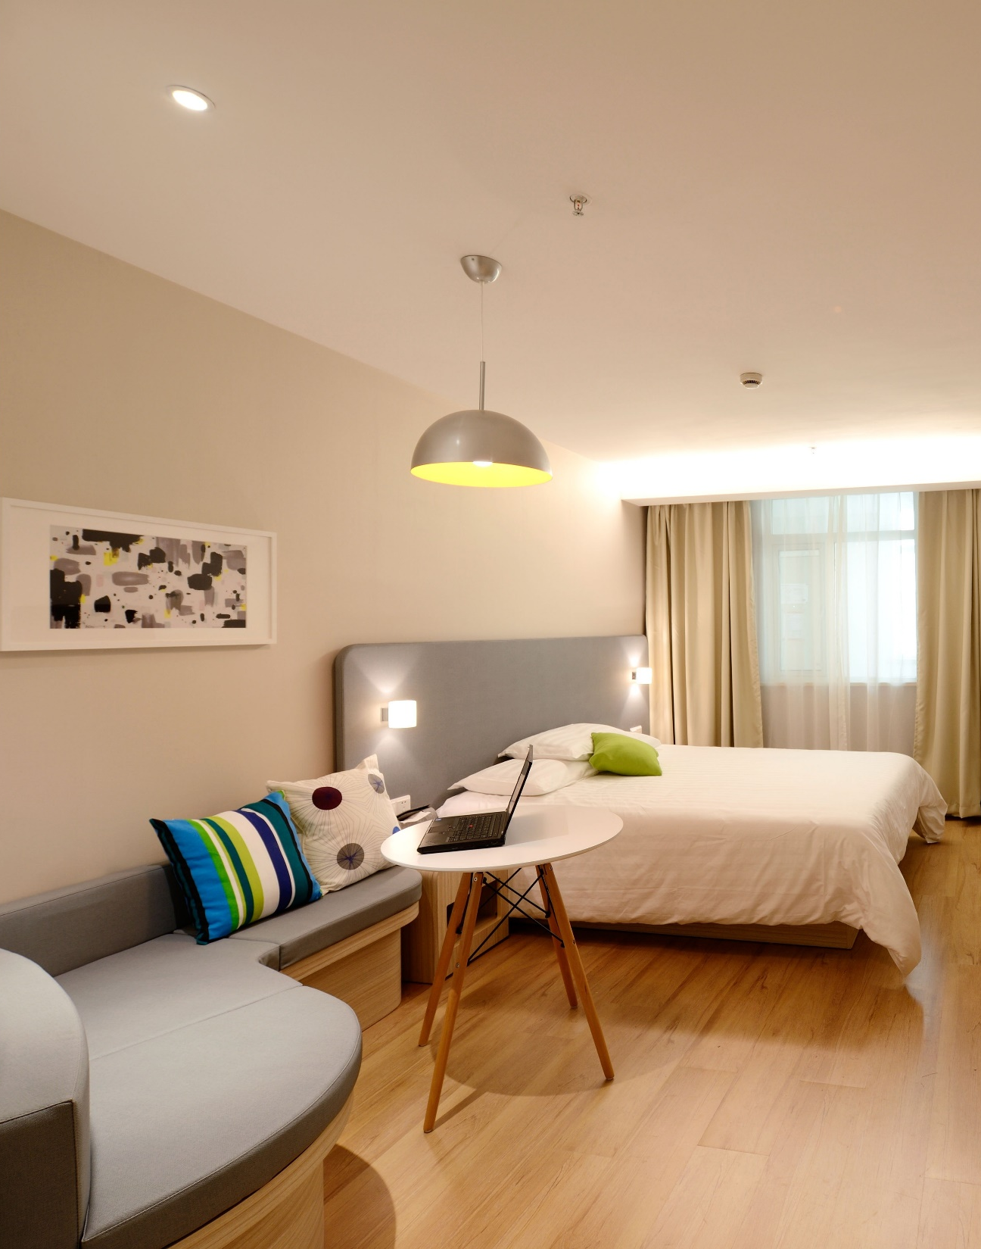

AirBed&Breakfast
Book Rooms With Locals, Rather than Hotels.
Shivani Rawat – 110103170
Nisha Verma - 110110492

Slide 2





Problem
Customer Experience
Loyalty
Bounce Rate
Challenge of guest to navigate through numerous host listings
Impacting guest satisfaction and repeat booking
High bounce rate

Slide 3



Market Share
100+ Million
31.12 %
00:08:10
Trips Booked Online
Bounce Rate
Average Visit Duration
Total Visits
Visitors leave webpage without taking an action

Slide 4

Enhanced Guest Satisfaction
Solution
Increased Guest Loyalty
Airbnb's Host Comparison feature where users can compare various hosts
Data-Driven Insights

Slide 5
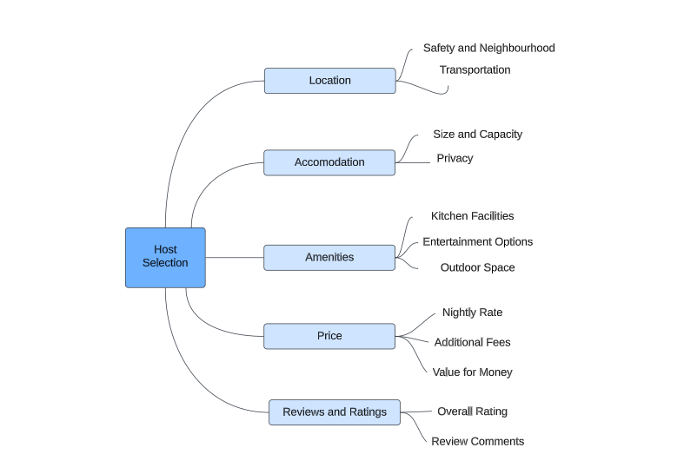
Analytic Hierarchy Process

Slide 6





Compare Hosts on Key Metrics
Accommodation
Price
For transaction-based temporary housing site
Compare prices between different hosts
Reviews
High ratings and positive reviews
Location
Amenities
The location of your accommodation can have a big impact on your overall experience.
Different hosts offer different amenities, so it's important to compare what's included

Slide 7

Evaluation of Alternatives
Hosts
Host 1 – Skylit Midtown Castle
Host 2 - BlissArtsSpace
Host 3 – Chelsea Perfect
Host 4 – West Slide Retreat
Host 5 – Country Space In The City

Slide 8
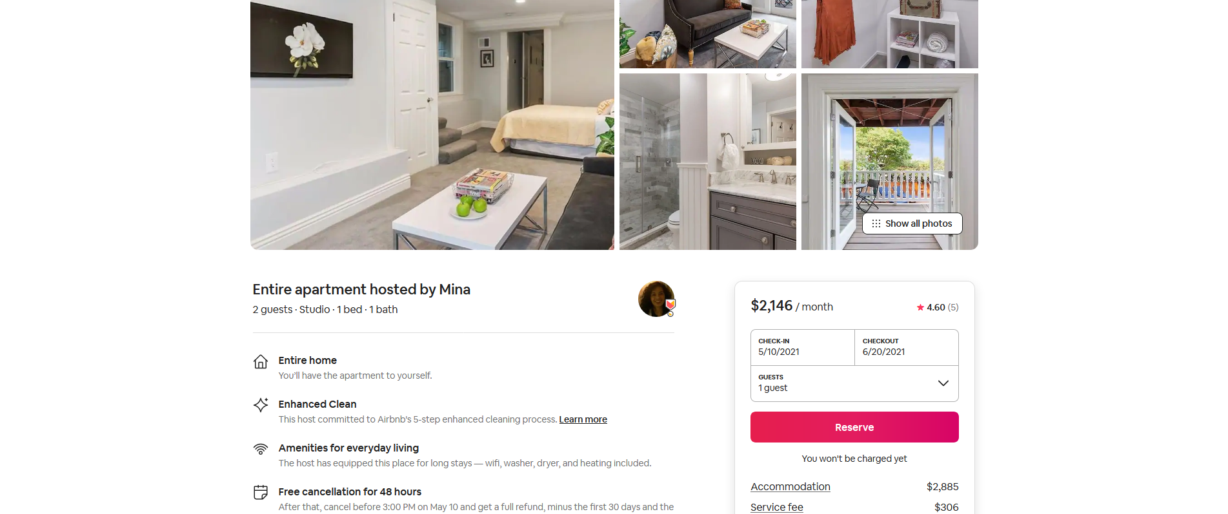

Product
Book It!

Slide 9

Final Evaluation
The priorities pertaining to the alternatives and pertaining to the evaluation criteria
and sub-criteria are synthesized to yield the overall numerical priorities for the alternative projects.
Host 1
Host 3
Host 5
1.1108
1.2201
0.9634

Slide 10




Conclusion
Streamlined Decision-Making
Customers can save time and make informed decisions
Transparency and Trust
This transparency helps build trust among users and increases loyalty
Website Retention Reduce bounce time and increase visit duration of the website Airbnb.com

Slide 11
Thank you!

